Slide 1
Custom BootCAMp IDA (Week-4)
Shivam Jindal

Slide 2
Introduction to arrays in python
Arrays are a collection of elements, each identified by an index or a key.
In Python, arrays are implemented using ‘array’ module.
Syntax: array(typecode, initializers)
Example: my_array = array('i', [1, 2, 3, 4, 5])
Indexing starts from 0.
append(x): Adds element x at the end of the array.
Arrays provide an efficient way to store and manipulate data in Python, especially when dealing with numerical data.
Arrays can be used for numerical computations, efficient storage of large datasets.

Slide 3
Array Creation Functions:
np.array()
np.zeros()
np.ones()
np.empty()
Array Manipulation Functions:
np.reshape()
np.transpose()
Array Input and Output Operations:
np.savetxt()
np.loadtxt()

Slide 4
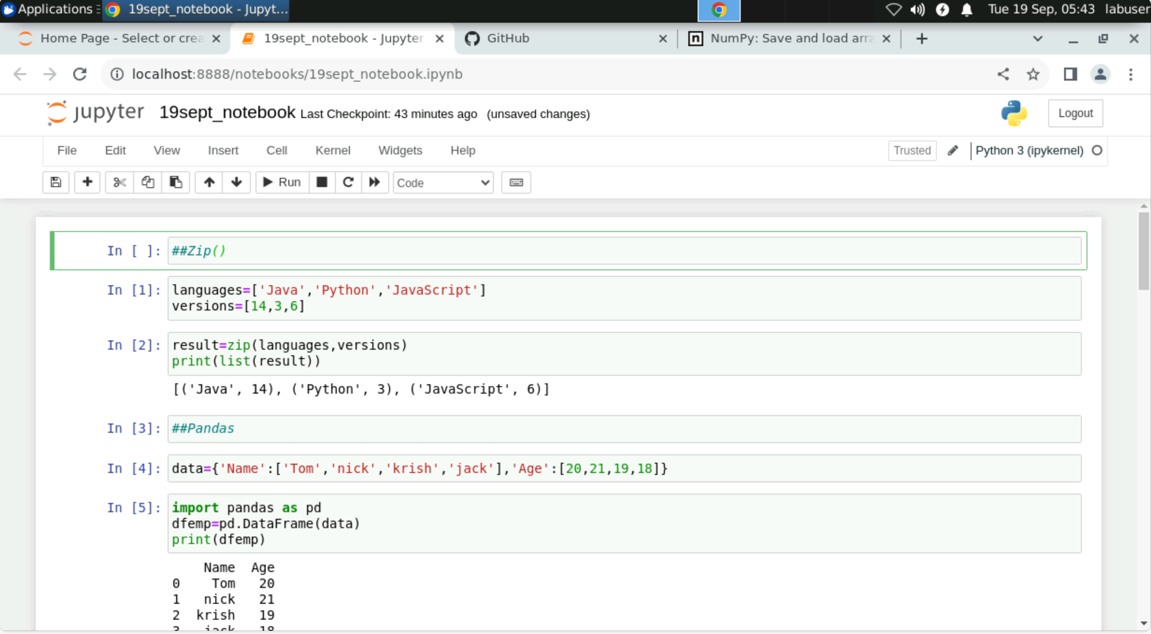
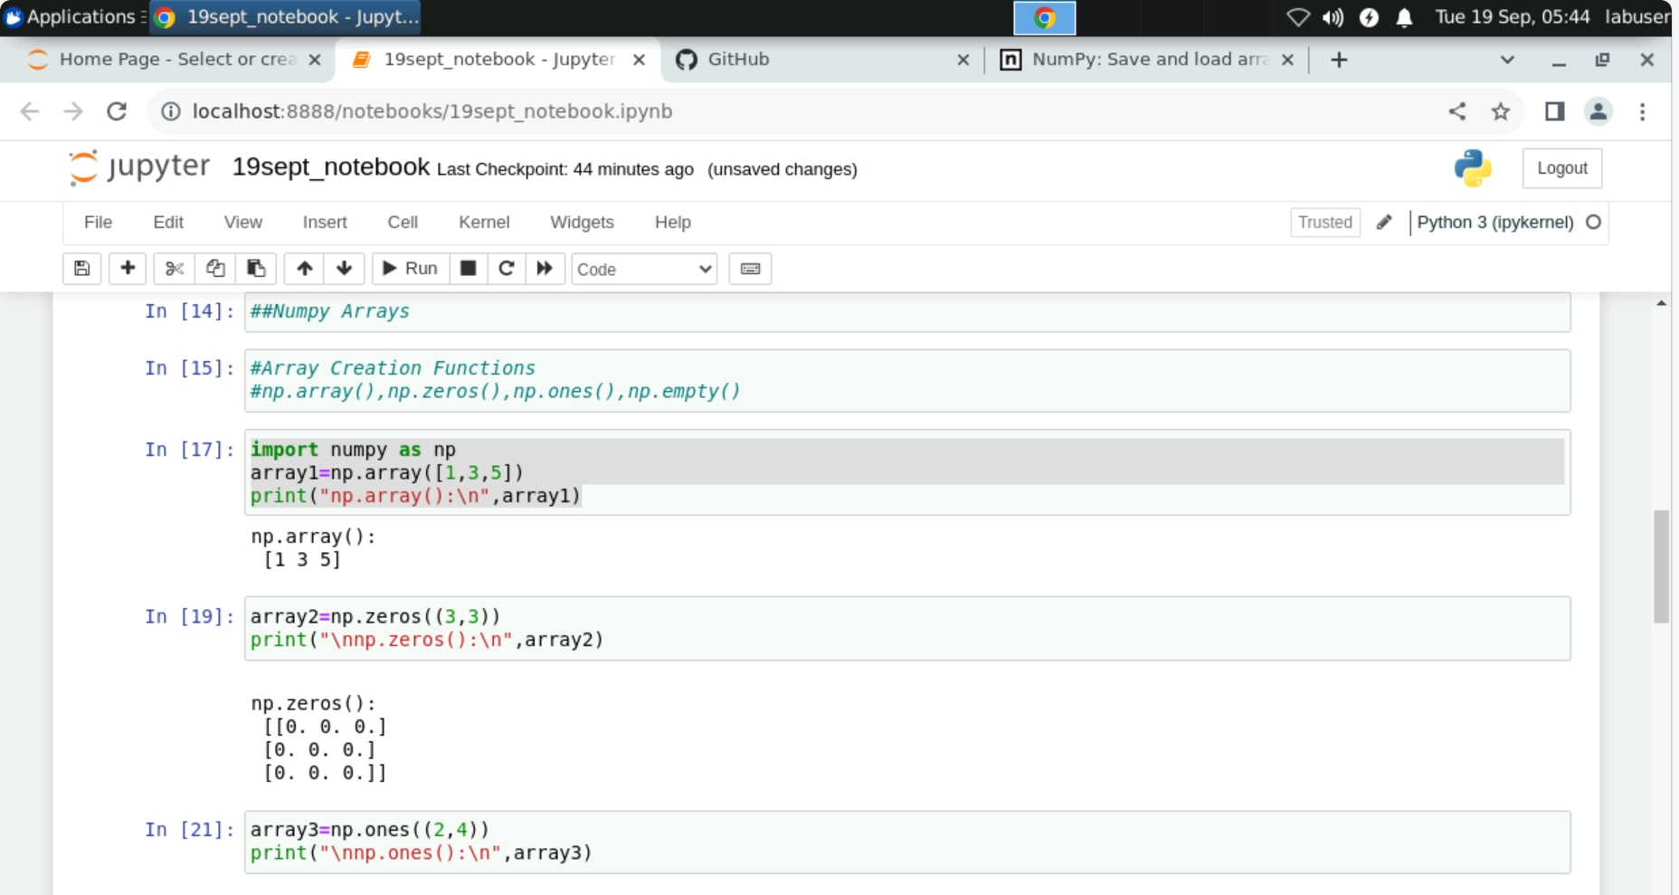

Slide 5
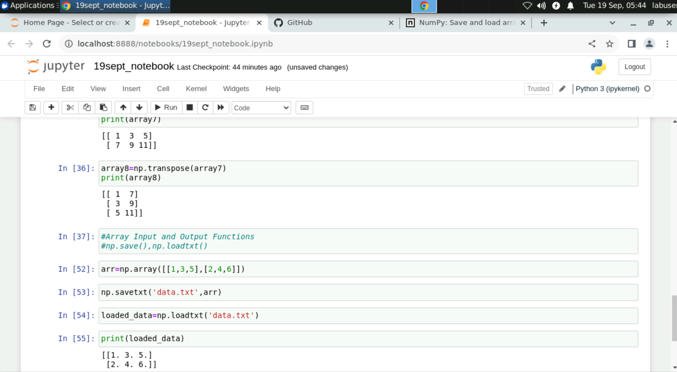
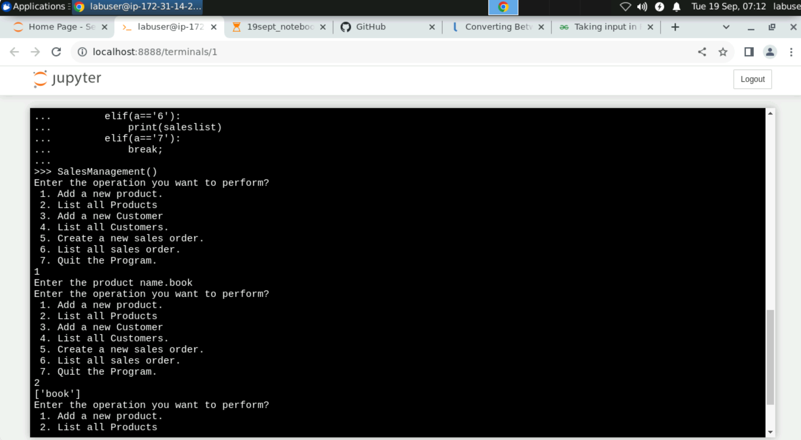

Slide 6
Scipy
Open-source Python library for scientific computing.
Key Features
Extends NumPy for advanced numerical operations.
Integration, optimization, signal processing, stats, and more.
Modules
Integrate, optimize, signal, stats, linalg, sparse, special
Use Cases
Research, engineering, data analysis, stats.

Slide 7
Scipy vs scikit-learn
Scientific and numerical computations
Low-level for numerical computations
Built on NumPy
Differential equations, signal processing
Active community and development
Machine learning algorithms and tools
User-friendly interface for ML tasks
Utilizes NumPy and SciPy along with others
Classification, regression, clustering, etc.
Active community and ongoing development

Slide 8
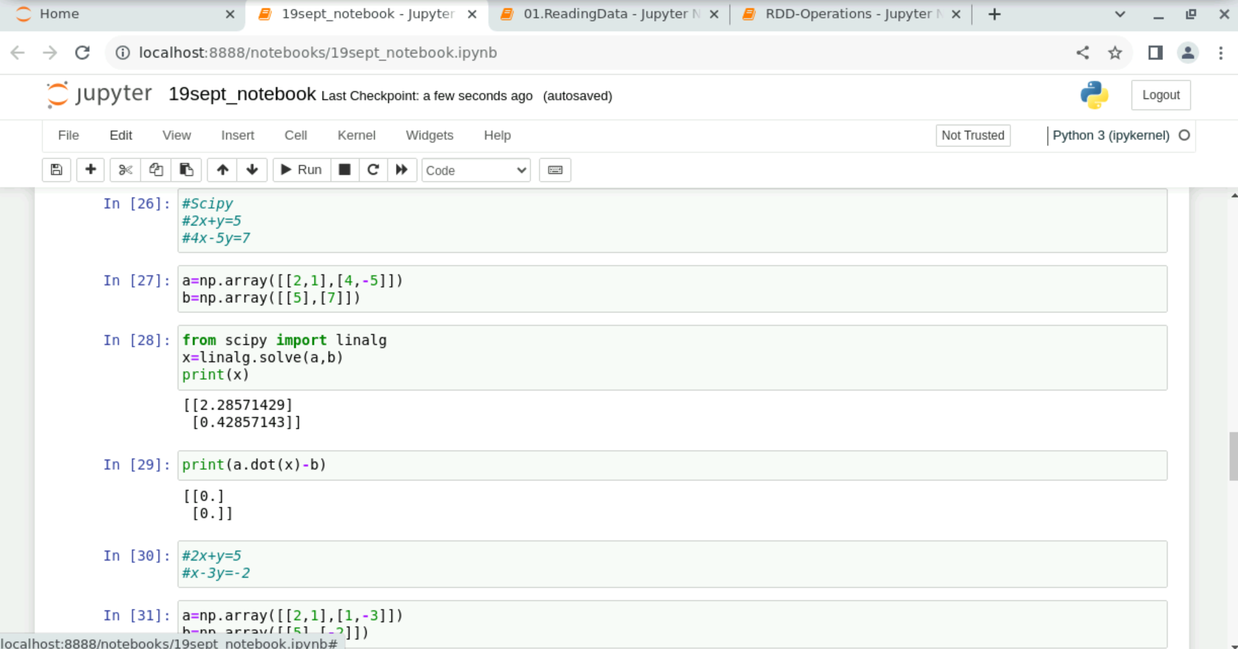
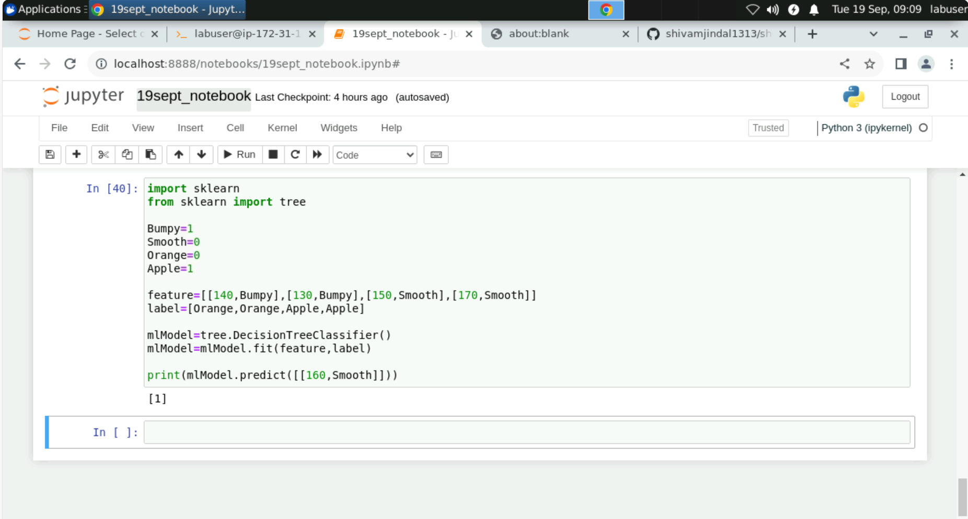

Slide 9
Apache Spark
Apache Spark is an open-source distributed computing system designed for big data processing.
Advantages of Spark:
Speed: Processes data up to 100 times faster than traditional MapReduce.
Ease of Use: Offers simple APIs for coding in Java, Scala, Python, and SQL.
In-Memory Processing: Stores data in RAM for rapid access and processing and analytics.
Why Spark?
Scalability: Scales effortlessly from a single machine to a cluster of thousands of machines.
Real-Time Processing: Enables real-time data processing and analytics.
Versatility: Works with a variety of data sources including HDFS, S3, Hive, and more.
Fault Tolerance: Recovers gracefully from hardware failures or other issues.

Slide 10
pyspark
Definition: PySpark is the Python library for Apache Spark, a powerful open-source distributed computing system.
Key Advantages:
Scalability: Handles large datasets by distributing tasks across a cluster.
Speed: Processes data quickly through in-memory computing and parallel processing.
Versatility: Compatible with various data sources and file formats.
Use Cases:
Big data processing, real-time analytics, and large-scale machine learning.

Slide 11
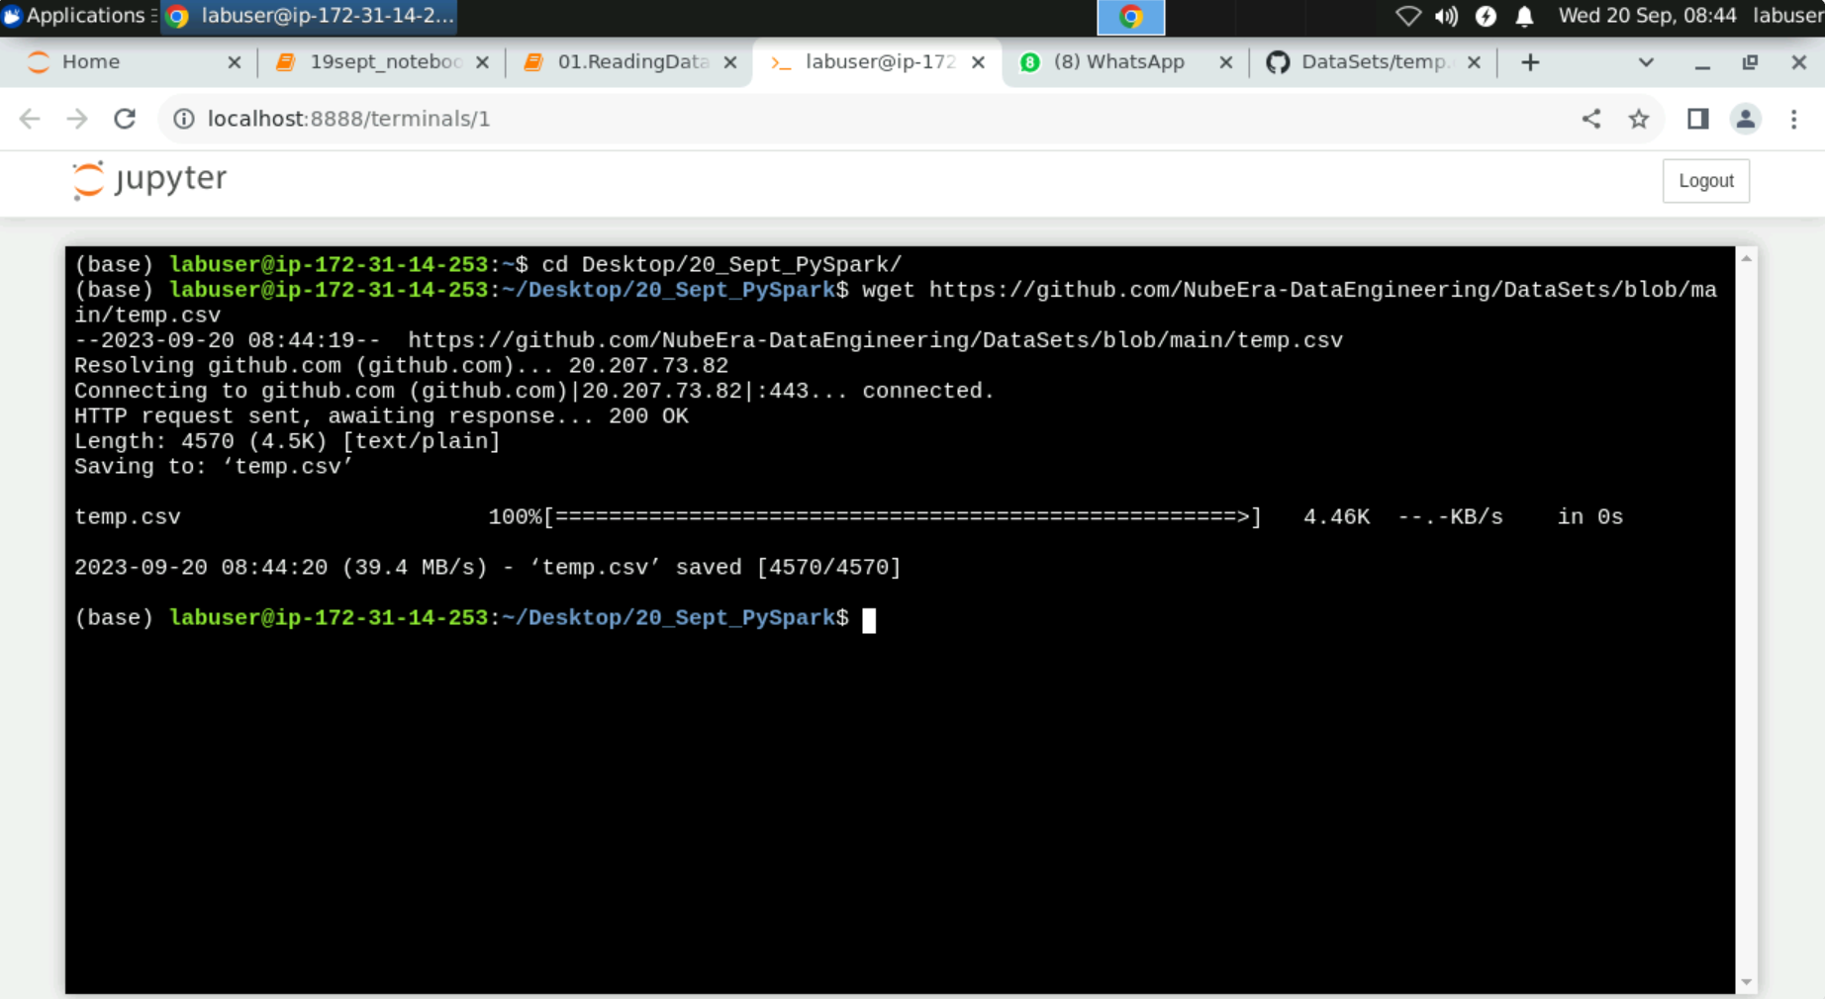
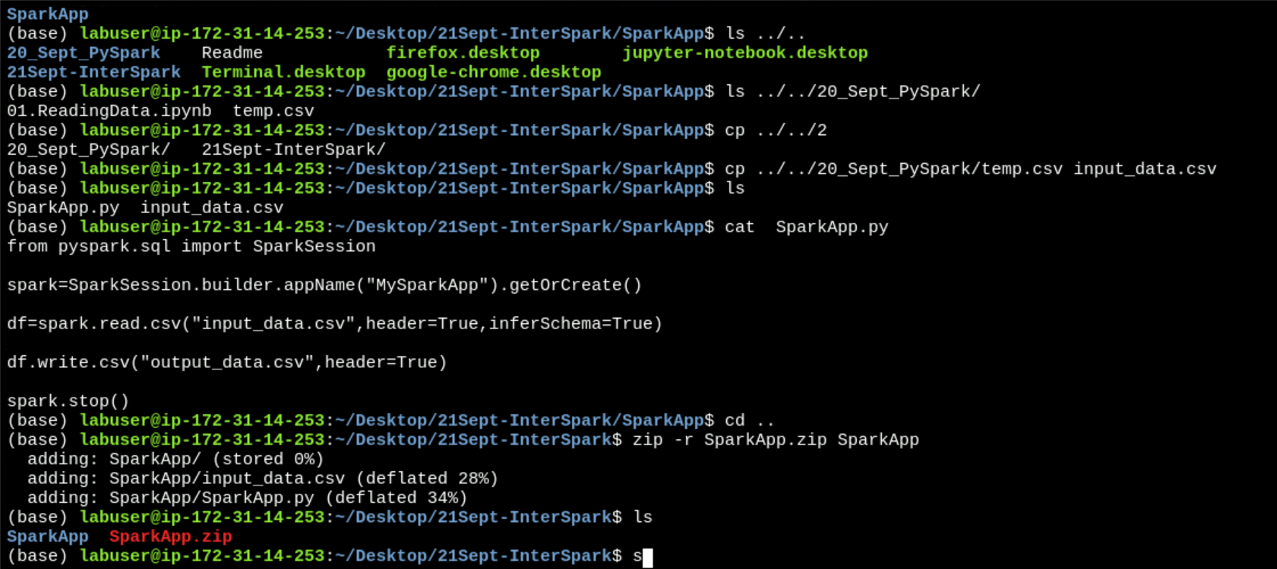

Slide 12
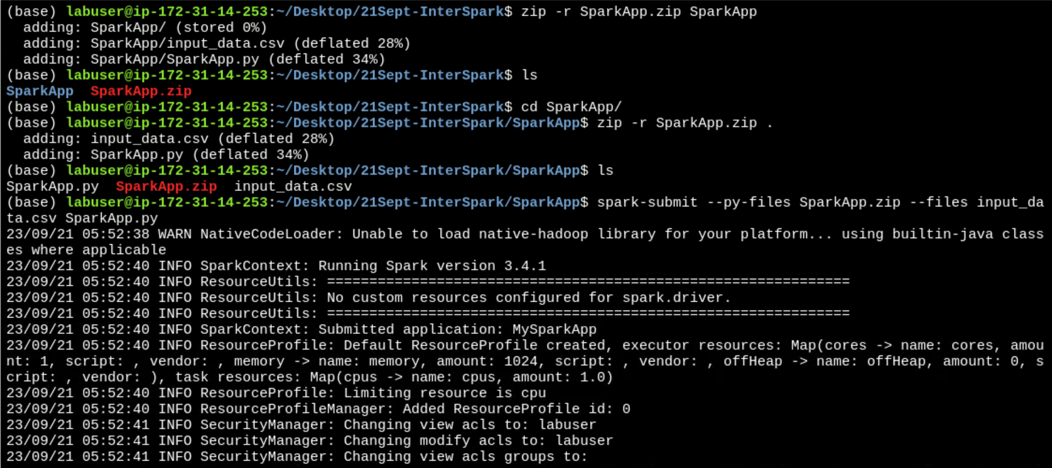
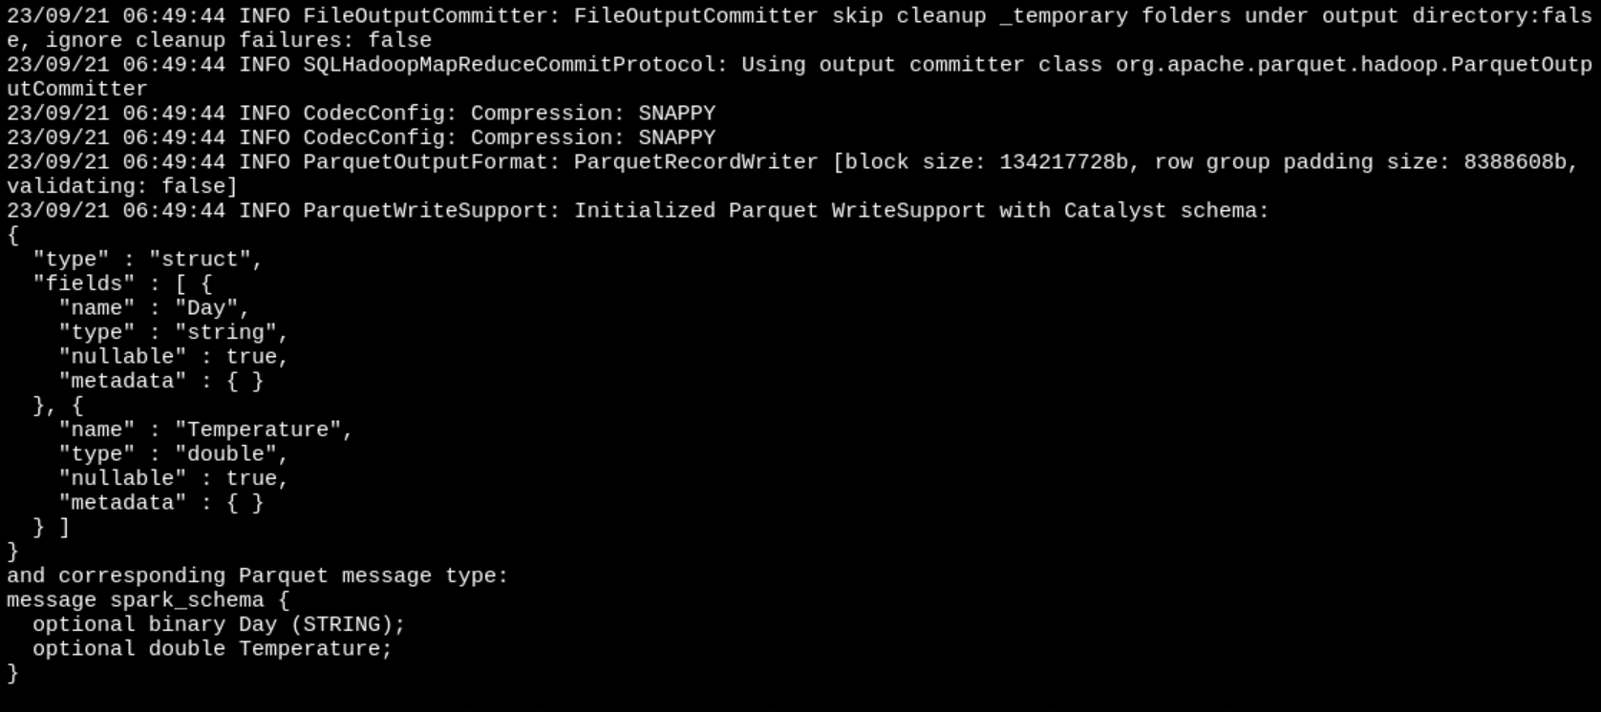

Slide 13
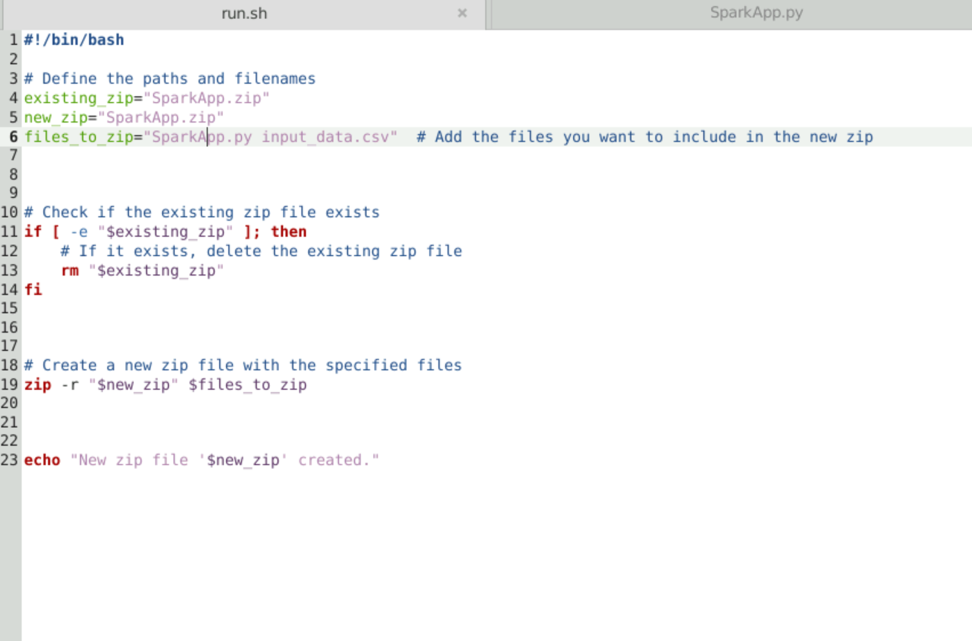
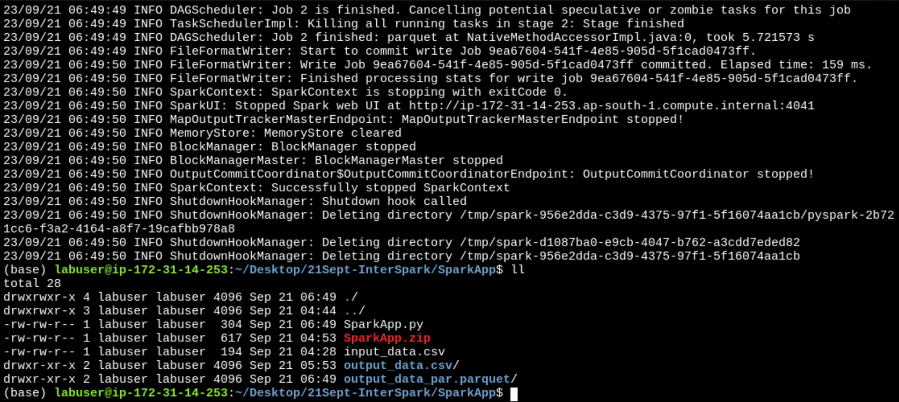

Slide 14
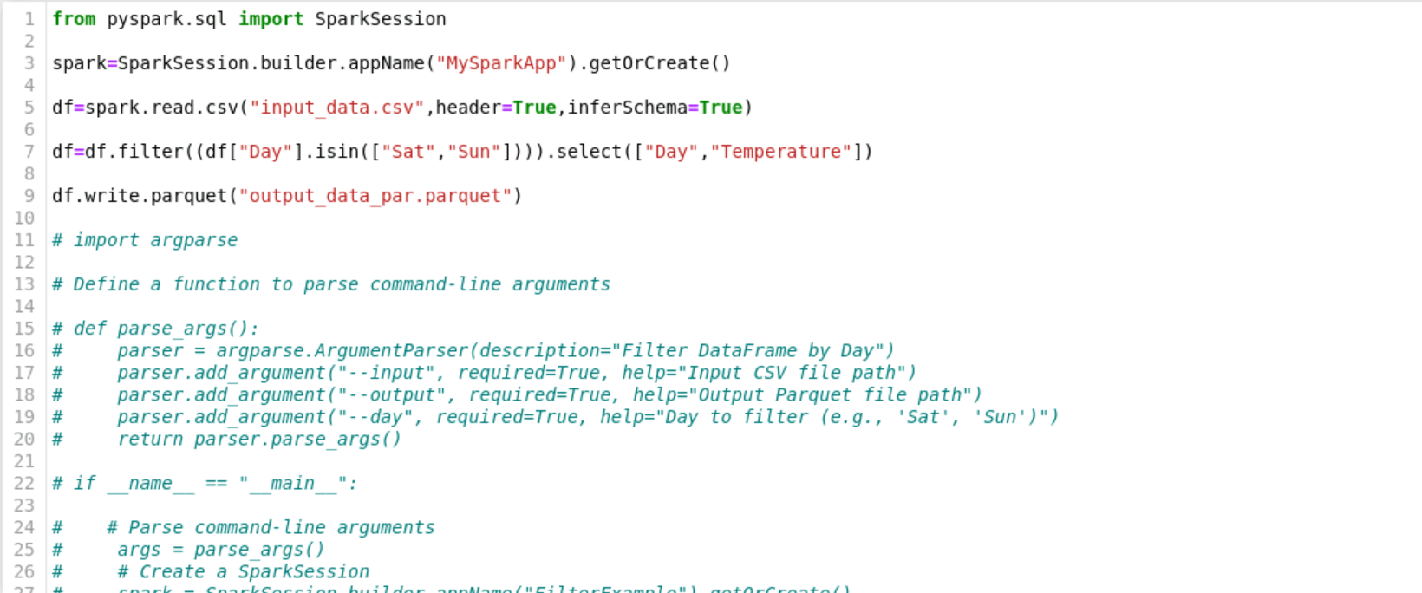
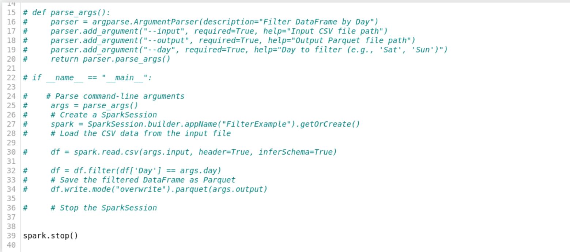

Slide 15
Resilient Distributed dataset(rdd) in apache Spark
Foundational data structure in Apache Spark, representing distributed collections of objects.
Immutable, meaning their content cannot be changed once created.
Can be distributed across multiple nodes in a cluster, allowing for parallel processing.
Fault-Tolerant.
Support two types of operations: transformations and actions.
Can be persisted in memory across operations using cache() or persist() methods.
Spark uses lazy evaluation, meaning transformations on RDDs are not executed immediately. They are executed only when an action is called.
RDDs are used for low-level data manipulation and distributed processing tasks in Spark.

Slide 16
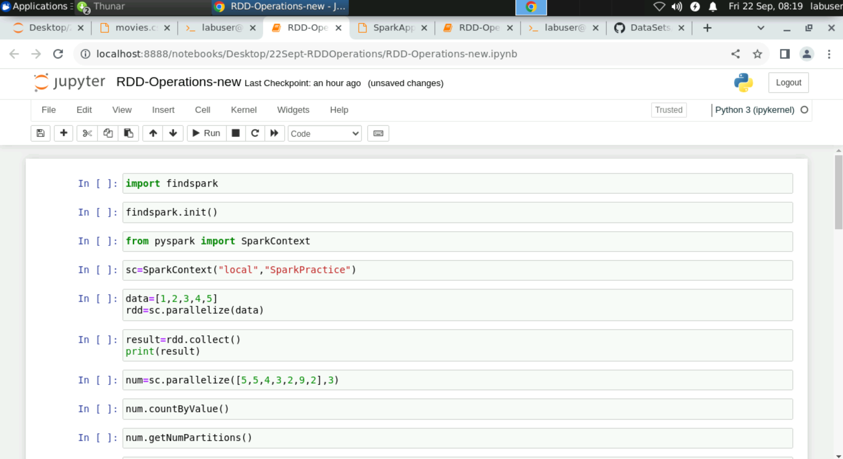
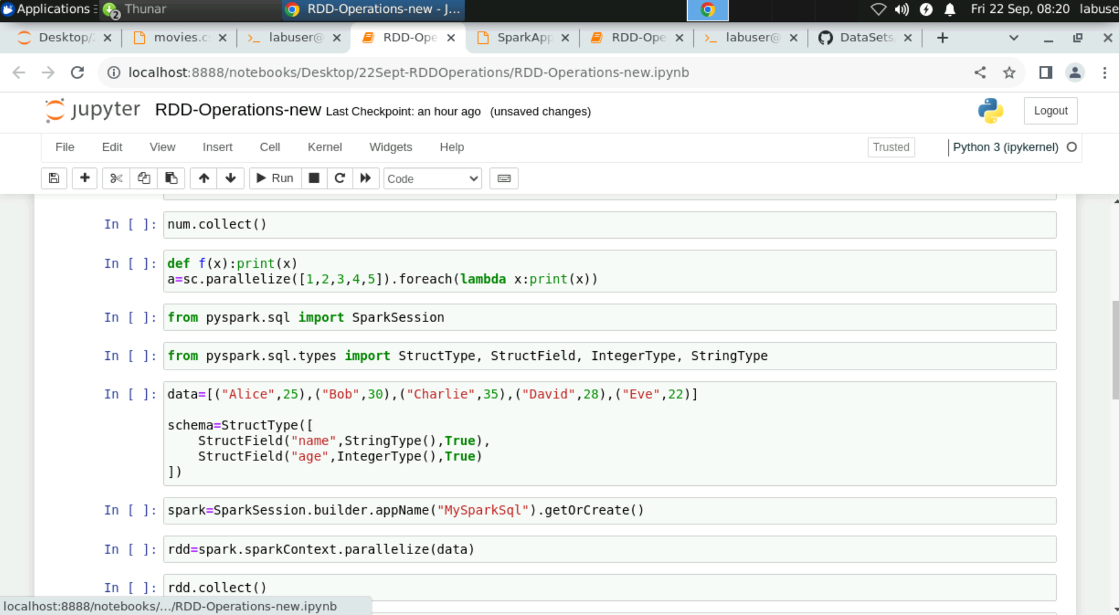

Slide 17
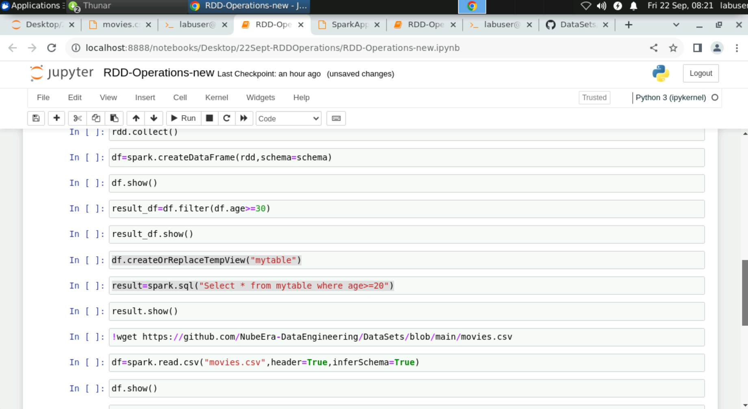
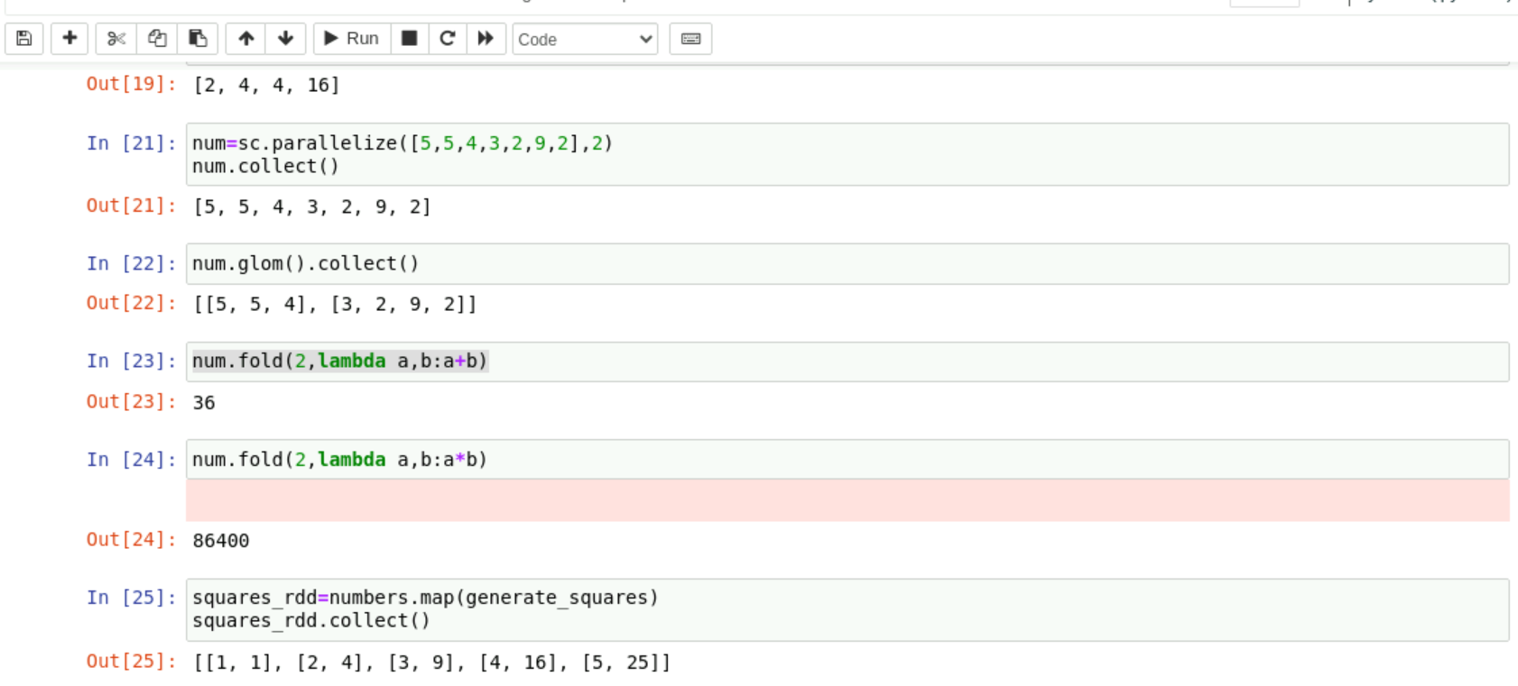

Slide 18
